Slide 1


Advanced CSS

Slide 2

Recap
HTML Structure
HTML Elements
CSS Rules
CSS Selectors

Slide 3
Today’s topics
CSS Properties:
CSS Box Model. Margin, Padding, Border
Position, Z-Index & Float.
display property
Responsive CSS (Media Queries)
Transitions, Transforms & Animations
Text & Box Shadow
Overflow
Web Fonts

Slide 4
CSS Box Model

Slide 5




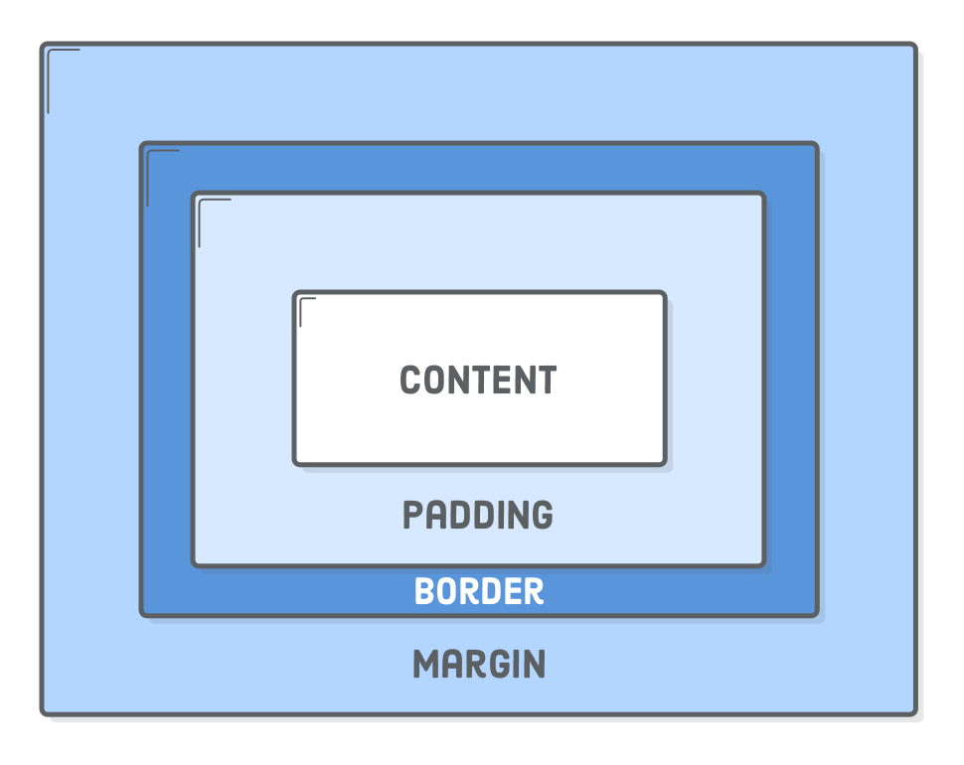







●
●
●
Each element has four sections:

Slide 6



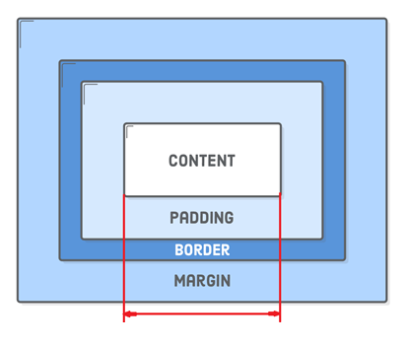
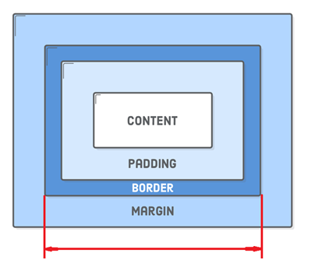
●
●
●
Width & Height for box-sizing: content-box (default)
Width & Height property for box-sizing: border-box

Slide 7


Slide 8






●
○
●
○
○
○

Slide 9







●
○
●
○
○
○
○
●
●
○

Slide 10







●
●
○
○
○
■
○

Slide 11








●
○
○
○
●
○
●

Slide 12




●
Demo. Use the following position values:
●
○
○
Z-index only works with positioned elements: relative, absolute, fixed, sticky

Slide 13
CSS display property

Slide 14






●
● Most common values (Standard):
○
○
○
○
●
○
○

Slide 15


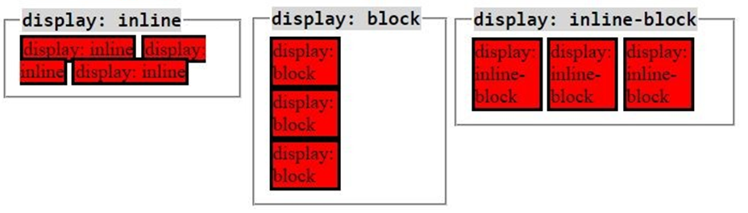
allow other elements to sit to their left and right
respect left & right margins and padding, but not top & bottom
cannot have a width and height set
force a line break after the block element
respect width, height, margin, padding
allow other elements to sit to their left and right
respect top & bottom margins and padding
respect height and width

Slide 16









●
●
○
○
○
●
○
○
○
○

Slide 17




: Flexbox
●
○
○
○
●
● Workshop: align an element vertically with flexbox
We can use display:flex to accomplish these issues

Slide 19





●
●
●
=
<link rel="stylesheet" type="text/css" href="screen.css" media="screen">
<link rel="stylesheet" type="text/css" href="print.css" media="print">
@media | (min-width: 700px) | { … }
@media | (min-width: 700px) | and (orientation: landscape) { … }
@media | tv and (min-width: | 700px) and (orientation: landscape) {…}

Slide 20










●
○
○
○
○
<meta name="viewport" content="width=device-width, initial-scale=1" />

Slide 21
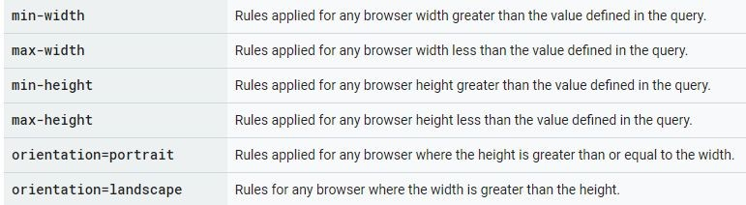
●
○
○
○
Step 2:

Slide 22


Slide 23

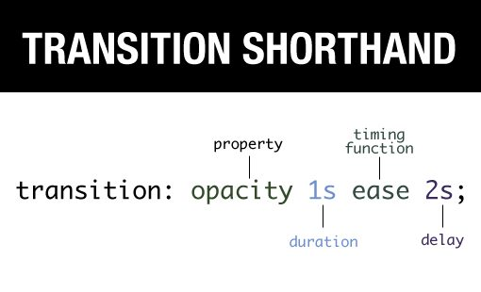
By default, all CSS properties are changed instantly
Transitions allow CSS properties to change gradually
An element can have one or more properties which transition
Specify multiple properties by separating with commas.
Can also transition all properties.
Options
Duration: how long the transition takes from start to end
Timing function: the type of transition: linear, ease, etc
Delay: wait a certain amount of time before starting the transition

Slide 24





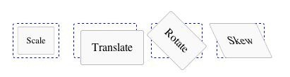




●
●
○
○
●
○
○
○
○
●
Two main properties:

Slide 25






●
●
@keyframes resize {
0% { height: 30px; } 100% { height: 60px; }
}
.element {
animation: resize 3s;
}
Example: Sprite Sheet animation

Slide 26




●
●
●
●
●
●
●
●

Slide 27
Text & Box Shadow

Slide 28

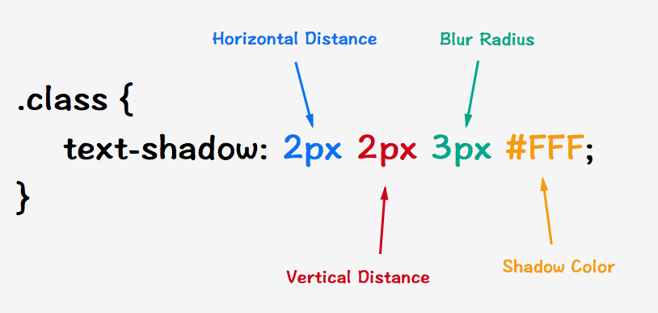



Applies a shadow to text within an element
More than one shadow value can be applied, which creates a stronger effect.
Examples below:
Chapter two
12

Slide 29
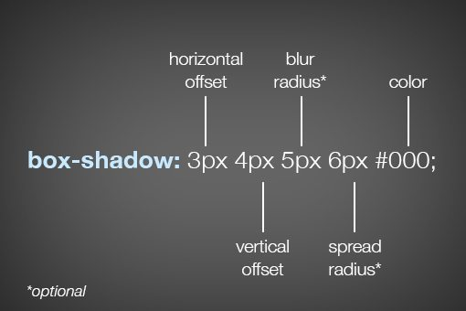

Box Shadow
Applies a shadow to the bounding box of an element
More than one shadow value can be applied, which creates a stronger effect.
box-shadow example
Chapter two
12

Slide 30
Web Fonts

Slide 31

●
●
You can use @font-face to load fonts from a local folder or from the Internet
The loaded fonts are then available to be used anywhere on the page
@font-face {
font-family: Fancy;
src: url('Fancy-Bold.ttf');
}
.my_class {
font-family: Fancy; font-size: 3.2em;
}

Slide 32
Resources
Responsive design (Media queries)
Theory: www.w3schools.com/css/css_rwd_mediaqueries.asp
@media rule details www.w3schools.com/cssref/css3_pr_mediaquery.asp
Bootstrap – CSS framework made for responsive design getbootstrap.com/
CSS Generators
Transitions and effects: css3generator.com/
Color gradients: www.colorzilla.com/gradient-editor/
Flexbox
Flexbox guide: css-tricks.com/snippets/css/a-guide-to-flexbox/
Learn CSS flexbox with Froggy: www.flexboxfroggy.com

